Slide 1
FlowTrak™ Warehouse Optimization Software Demonstration
FlowTrak™ Warehouse Optimization Software Demonstration

Slide 2
Agenda | Table of Contents
Warehouse Optimization Background page 2
Introduction to FlowTrak & Streamsoft, LLC page 6
Warehouse Design & Analysis Demo page 10
Initial Profiling/Slotting Demo page 13
Re-Profiling/Optimization Demo page 16
FlowTrak Implementation page 22
Additional Considerations page 26
1

Slide 3
Warehouse Optimization Background
2

Slide 4
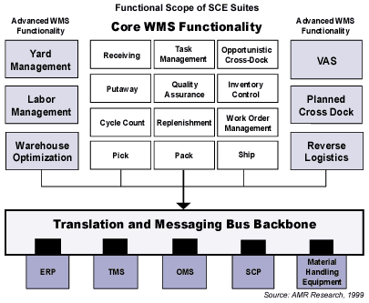
Warehouse Optimization Definition
The process of continually maintaining an optimal SKU profile by taking into account the extent to which factors that influence the movement, staging, and storage of the SKUs are fluctuating and their cost impact to the operation.
Warehouse Optimization is considered essential to world-class warehousing
3

Slide 5
Why Warehouse Optimization?
Regardless of industry, supply chains are being forced to become shorter, more flexible, accurate, and reactive. DC operators seek world class warehouse optimization software to help manage adverse warehouse effects brought about by changing market forces.
Market Force | Warehouse Effect
Customers want more choices | SKU proliferation
Customers tastes evolving more rapidly | Shorter product life cycles
Customers are ordering more items on-line (Internet, intranets, portals) | Diversification of order line quantities
Customers expect faster response to orders | Increased pressure on throughput rates
Customers demand accurate shipments | Increased pressure on order accuracy
4

Slide 6
Key Areas Addressed with Warehouse Optimization
FlowTrak software helps you proactively address slotting-related bottlenecks and inefficiencies caused by changes in your operating environment. Leverage FlowTrak to address these key issues:
  Inappropriate racking for SKU mix
  SKUs not slotted where they belong
  Slot capacity and opening not sized properly for SKU
    leads to…
    Excessive replenishments.
    Numerous stock-outs or delays in completing waves.
    Shortage of racking in certain areas.
    Poor productivity across facility.
    Excess travel time in picking and replenishing.
    Poor ergonomics in picking, leading to product damage
5

Slide 7
Introduction to FlowTrak
6

Slide 8
FlowTrak Background
A few key facts about FlowTrak software:
  Developed in 1998 by Streamsoft, LLC - a Chicago based software company.
  Re-sold through 3 Systems Integrators and 4 WMS Vendors as a value added solution complementing existing product/service suite.
  Has been or is being planned for implementation in over 38 warehouse sites comprising 28+ million sq. ft. and 840,000+ SKU’s.
  Standard platform is a PC-based system with Windows NT operating system, Microsoft SQL Server database, Crystal Reports reporting software.
  Operates as stand-alone software or can be tightly integrated with any WMS.
7

Slide 9
FlowTrak Capabilities
FlowTrak provides three major capabilities – Warehouse Design & Analysis, Initial Slotting, and On-going Optimization – to help you attain maximum labor and equipment productivity.
FlowTrak Capability | Results
Analyze | Needed racking requirement analysis (linear feet of racking) Recommended fixture type allocation to SKUs (bin shelving vs. pallet flow lanes) Overall productivity rates, replenishment requirements, and throughput volumes by product grouping
Slot | Ideal SKU to Location assignment throughout warehouse Precise Location sizing (opening size, capacity) to meet on-hand inventory requirements Exact SKU slotting characteristics (# faces, orientation) to maximize utilization of racking space
Maintain | Analysis of SKU moves required to improve overall profile Generation of moves report to maximize utilization of labor in completing moves
8

Slide 10
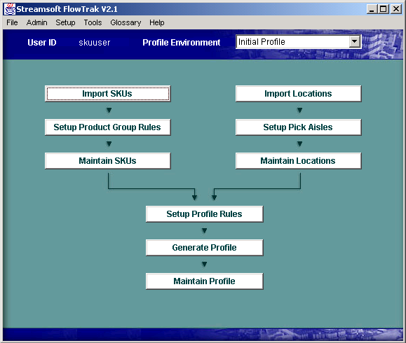
FlowTrak Design
FlowTrak’s screen design and structure makes the software easy to learn, use, and configure. The following illustration indicates the basic layout of FlowTrak as it relates to functionality.
SKU Data
Location Data
Product Group
Setup
Aisle Range
Setup
SKU’s are imported and categorized into Product Groups
Locations are configured by Aisle Range
Profiling Setup
& Execution
Aisle Ranges are assigned to Product Groups and Profiling is Executed
9

Slide 11
Warehouse Design & Analysis
10

Slide 12
Design & Analysis Goals
Situations which are appropriate for using FlowTrak to perform warehouse design and analysis:
  Need to confirm that available racking is adequate for desired on-hand inventory levels.
  Want to know the needed mix of forward pick racking to handle disparate SKU order profiles and sizes.
  Operating environment has changed or is better understood since original racking was designed.
  Planning an expansion or modification of racking for change in SKU mix.
11

Slide 13
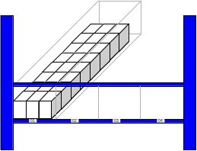
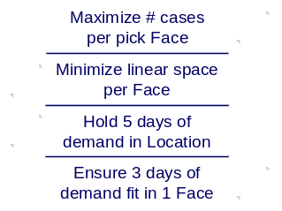
Design & Analysis Methodology
To determine the best type of forward pick locations, FlowTrak uses the following methodology to analyze each SKU.
1. Identify and setup all Rack Types for evaluation. Organize into Product Groups.
1
01
01
02
02
03
03
04
2. Determine SKU Fit/Orientation strategy for each Product Group.
04
2
3. Configure Cube Utilization strategies for each Product Group.
4. Set threshold values and filtering criteria for each Product Group.
5. Add other criteria to each Product Group to complete warehouse analysis setup.
Total Linear Feet:
0001234.2
6. Run FlowTrak SKU Assignment and evaluate Reports.
Total Locations:
0000220
Total Shelves:
0000058
12

Slide 14
Initial Profiling
13

Slide 15
Initial Profiling Goals
Situations which are appropriate for using FlowTrak to perform warehouse initial profiling setup:
  Planning a new warehouse start-up and need ideal pick location assignments for all SKU’s.
  Going-live with a new WMS and need ideal SKU to pick location assignments to configure system prior to start-up.
  Have enough down time to re-configure racking and re-locate SKUs on a large scale.
  Expanding the warehouse for a new line of SKUs.
14

Slide 16
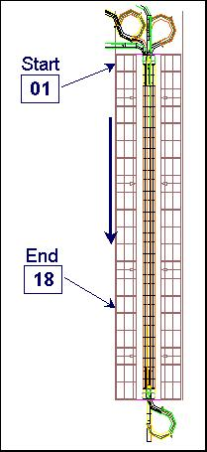

Initial Profiling Methodology
To slot SKUs into pick locations, Aisle Range and Slotting strategies are configured for assignment to Product Groups.
1. Configure ‘Rack Types’ for all possible bay configurations within the Warehouse.
2. Create Aisle Ranges by specifying start/end bay numbers, slotting sequence, and a Rack Type.
Location Flat File
3. Import location data from WMS to populate location master (Optional).
E22119A1|E|19079811-1|ESA|42|100||45
E22119A2|E|22035411-3|ESA|42|100||45
E22119B1|E|34531911-1|ESA|42|100||49
E22119B2|E|21281911-1|ESA|42|100||49
E22120A1|E|90027911-1|ESA|42|100||45
E22120A2|E|10171711-1|ESA|42|100||45
E22120B1|E|19465211-1|ESA|42|100||49
4. Sequence Aisle Ranges, select a slotting method, and assign to a Product Family.
.
.
.
5. Generate Initial Profiles for every Product Group and verify with reports and error logs.
Aisle Range #1
Aisle Range #2
Aisle Range #3
Sequentially by Aisle by Shelf
15

Slide 17
Optimization/Re-Profiling
16

Slide 18
Optimization/Re-Profiling Goals
Situations which are appropriate for using FlowTrak to perform on-going warehouse optimization:
  Want to incrementally improve profile over the long-term.
  Need to re-slot SKUs to account for recent change in sales history/forecasts.
  Entering a new season and need to adjust slotting assignments for expected volume changes and new/discontinued SKU’s.
  Planning a change in racking or warehouse layout and need to identify new slotting assignments.
17

Slide 19
Optimization/Re-Profiling Methodology
To analyze and identify SKU moves that will optimize the current profile, a re-profile is executed as follows:
1. Import current SKU/Location assignments into ‘Current Profile’.
CURRENT PROFILE
COPY OF CURRENT
PROFILE
1
2
2. Make a copy of ‘Current Profile’ and call it ‘Optimal Profile’.
3. Re-assign SKUs to Product Groups and re-configure other desired changes.
3
4
4. Execute a Re-Profile and compare with ‘Current Profile’ to analyze moves.
5
5. Select quantity and type of optimization moves and execute.
OPTIMIZED PROFILE
OPTIMAL PROFILE
18

Slide 20
Re-Profiling Benefits Example
The following demo scenario illustrates the type of benefits which may be achieved through re-profiling.
Scenario:
  1,650 Case-picked SKU’s that can be moved through 3 different types of forward pick locations – 3 deep Pallet Flow, 2 deep Pallet Flow, Pallet Stack. There is opportunity to improve replenishment and picking productivity:
  Replenishment
  Slot fastest moving SKU’s in lower levels of Case Pick Module to improve overall productivity.
  Allocate high cube movers to Pallet Flow lanes to maximize space utilization and increase on-hand capacity.
  Picking
  Slot fastest moving SKU’s Case Pick module to improve overall productivity.
19

Slide 21
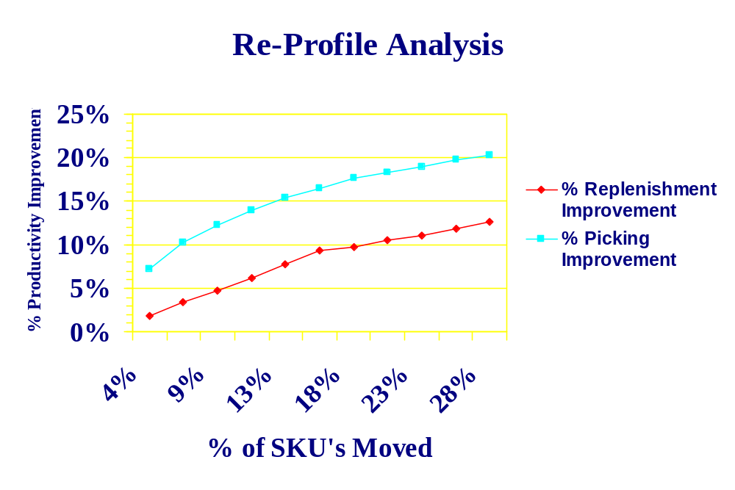
Re-profiling Benefits Example
Each warehouse will have different factors which contribute to the overall effectiveness of re-profiling. However, the following graph indicates a typical cost/benefit curve for re-profiling moves.
20

Slide 22
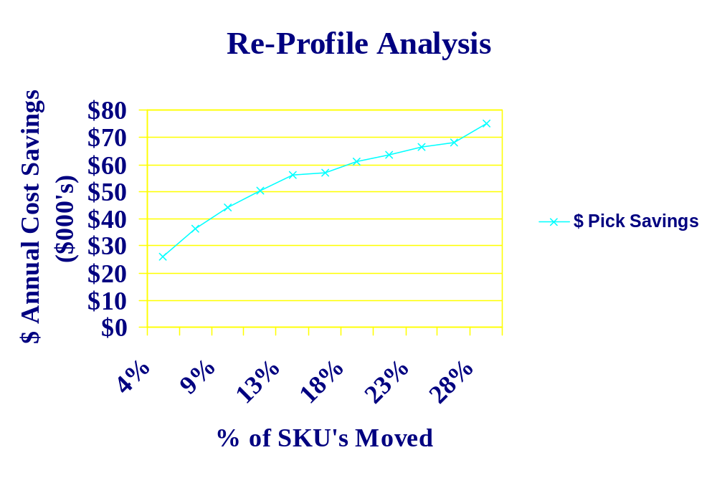
Re-profiling Benefits Example
Productivity improvements yield real cost savings in picking operations.
21

Slide 23
FlowTrak Implementation
22

Slide 24
FlowTrak Implementation - Analysis
The following are tasks that are required during the Analysis phase of a FlowTrak implementation project.
Project Phases | Wk 1 | Wk 2 | Wk 3 | Wk 4 | Wk 5 | Wk 6
Analysis
Design
Execution
Completion
ANALYSIS (3-5 days)
Analyze current operation practices, layout, rack types, SKU mix, volumes
Identify SKU & Location data for import and required effort to interface/cleanse
High level introduction to software and configuration
Recommend optimal slotting strategies for product groupings
Project plan completion
23

Slide 25
FlowTrak Implementation - Design
The following are tasks that are required during the Design phase of a FlowTrak implementation project.
Project Phases | Wk 1 | Wk 2 | Wk 3 | Wk 4 | Wk 5 | Wk 6
Analysis
Design
Execution
Completion
DESIGN (8-12 days)
Import SKU/Location data; develop data interfaces
Configure Product Groups, FlowTrak Aisle Ranges and Profiling Rules
Identify and develop software customizations for unique slotting requirements
Modify and prepare key slotting reports
24

Slide 26
FlowTrak Implementation - Execution
The following are tasks that are required during the Execution phase of a FlowTrak implementation project.
Project Phases | Wk 1 | Wk 2 | Wk 3 | Wk 4 | Wk 5 | Wk 6
Analysis
Design
Execution
Completion
EXECUTION (8-12 days)
Execute re-profile to analyze and identify moves
Check error logs and optimization reports and update configuration
Train key users; document procedures
Output moves via flat file or report for execution
25

Slide 27
Additional Considerations
26

Slide 28
FlowTrak – WMS Interface
FlowTrak can be interfaced to WMS packages for the seamless transfer of data between applications.
  On-going maintenance of SKU-location data necessary on one application instead of two.
  Immediate ability to re-profile the warehouse based on SKU parameter changes due to seasonality, discontinuance, short product life cycles.
  Ability to allocate & track product movement generated during Re-Profiling within WMS.
SKU & Loc
Data
Interface
WMS
FlowTrak
Optimization
Moves
27

Slide 29
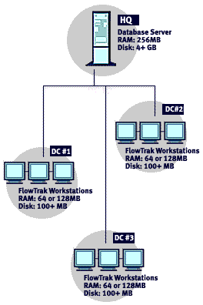
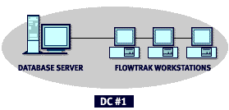
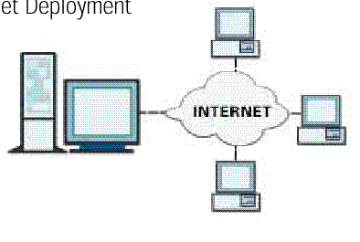

Hardware Options
FlowTrak can be utilized from a central server, from servers located at each DC, or across the Internet/Intranet. Your PC requirements will depend on the number of SKU/Locations you plan to profile and the number of DCs you plan to support.
Centralized
Separate DCs
Internet/Intranet
GUI
•
•
Web
•
•
•
28

Slide 30
Project Costs
Approximate range of costs for a warehouse optimization project in one warehouse facility, excluding hardware:
 | Cost Components
Software Costs | TBD
Maintenance & Support Costs | 15% of License Fees
Services (excluding travel expenses) | TBD
TOTAL | TBD
29

Slide 31
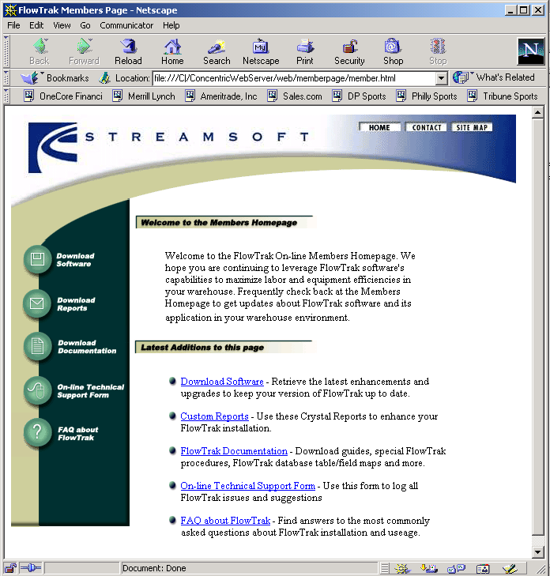
Maintenance & Support
The following standard offerings are available when you purchase maintenance & support with your software license.
  1 business day response to any issue or question.
  3 hours per month of phone support during normal business hours.
  Assistance with standard installation of software.
  All future upgrades of software and standard Crystal reports.
  Updated documentation including User’s Guide.
  Exclusive access to our Member Support Home Page at www.flowtrak.com ➔
30

Slide 32
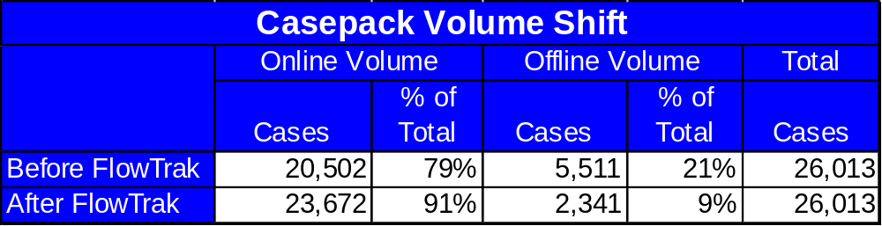
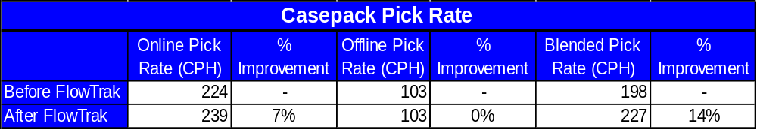
Customer Pilot Site Results
Shifts in volume between on-line and off-line resulted in direct benefits to overall productivity.
31

Slide 33
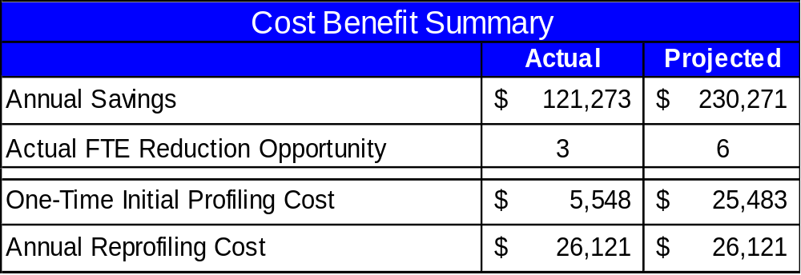
Customer Pilot Site Results
Full ROI on site license fee is realized within 3 months of implementation.
With additional activities, benefits are projected to improve in Casepack.
  Continue casepack product movement between on-line and off-line locations.
  Concentrate volume in the lower levels of the modules to facilitate replenishment productivity improvement.
  Multi-face high cubic velocity items to reduce selection location stock-outs.
  Evaluate items in the non-conveyable area for conveyability and move those into casepack modules.
32

Slide 34
Contact Information
For more information, please contact:
Paul R. Maurer
Streamsoft, LLC
639 W. Diversey Parkway
Chicago, IL 60614
pmaurer@streamsoft.net
Main: (773) 348-3322
Fax: (773) 348-3323
www.streamsoft.net or www.flowtrak.com
33

